Slide 1

UNIVERSITY INSTITUTE OF ENGINEERING
COMPUTER SCIENCE ENGINEERING
Bachelor of Engineering (Computer Science & Engineering)
Subject Name: STATISTICAL METHODS USING R
Subject Code: 20SMT-460
Continuous distributions
Mapped with CO
Prepared By:
Ms. Hardeep Kaur
DISCOVER . LEARN . EMPOWER

Slide 2
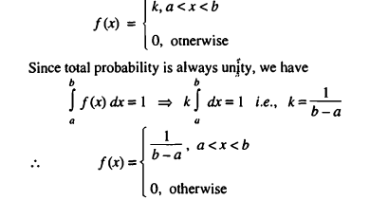
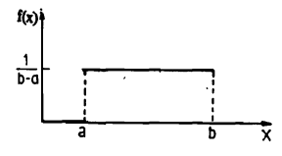
Rectangular or Uniform Distribution
A random variable X is said to have a continuous uniform distribution over an interval (a, b) if its probability
density function is constant = k (say), over the entire range of X, i.e.,

Slide 3
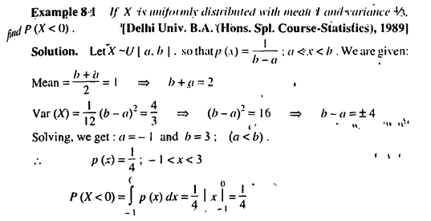
Examples

Slide 4
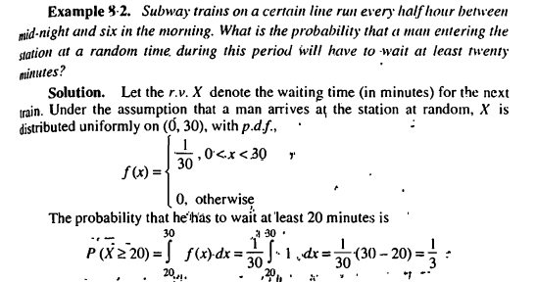
Examples

Slide 5
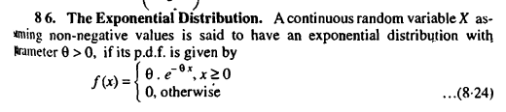
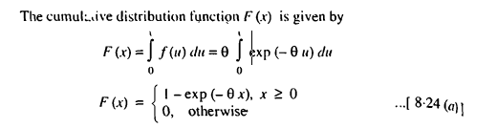
Exponential Distribution

Slide 6
